Slide 1

Pre-Requisite Result Management System
Muhammad Adnan Bajwa (01-249221-008)
MS students, Bahria University,
Islamabad, Pakistan
Supervisor:
Dr. Fatima Khalique
Assistant Professor, Computer Sciences
Bahria University Islamabad, Pakistan

Slide 2
Introduction
This database application would be used by teachers or university administrator
User will register the Pre-Requisite course
Student will be enrolled against each course
Results will be produced for every relevant course

Slide 3
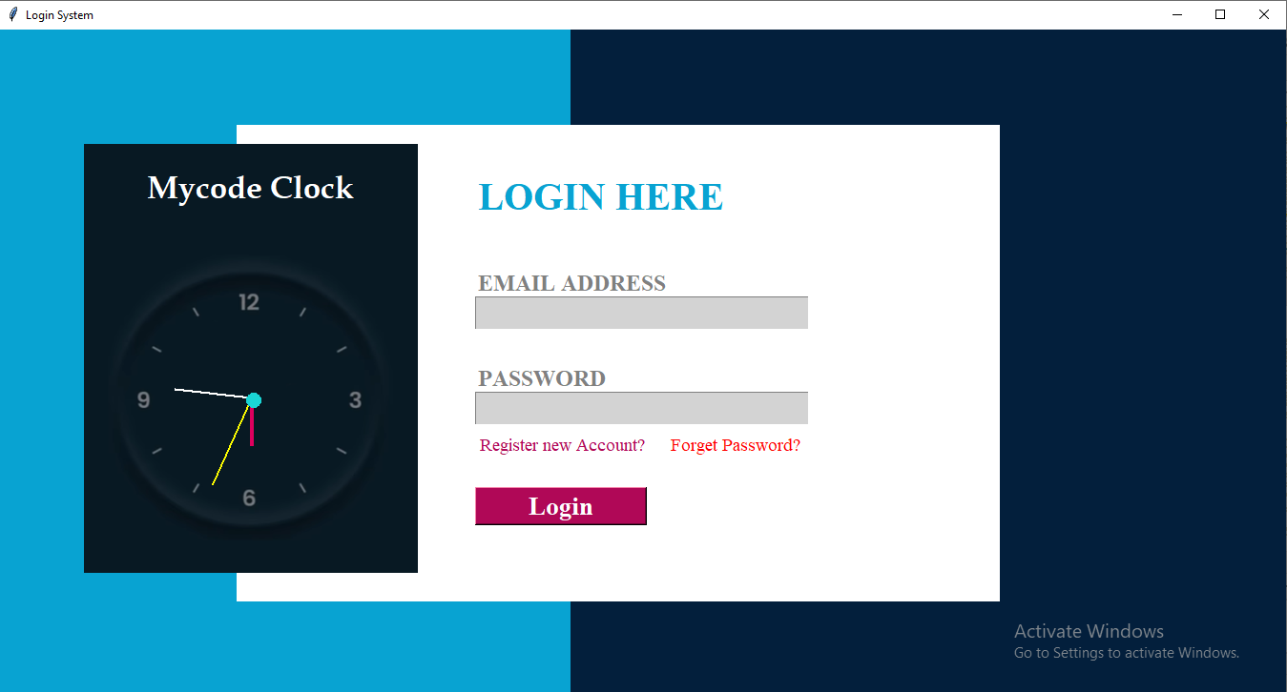
Login Page
When the application will be started, login page will appear as our first landing page

Slide 4
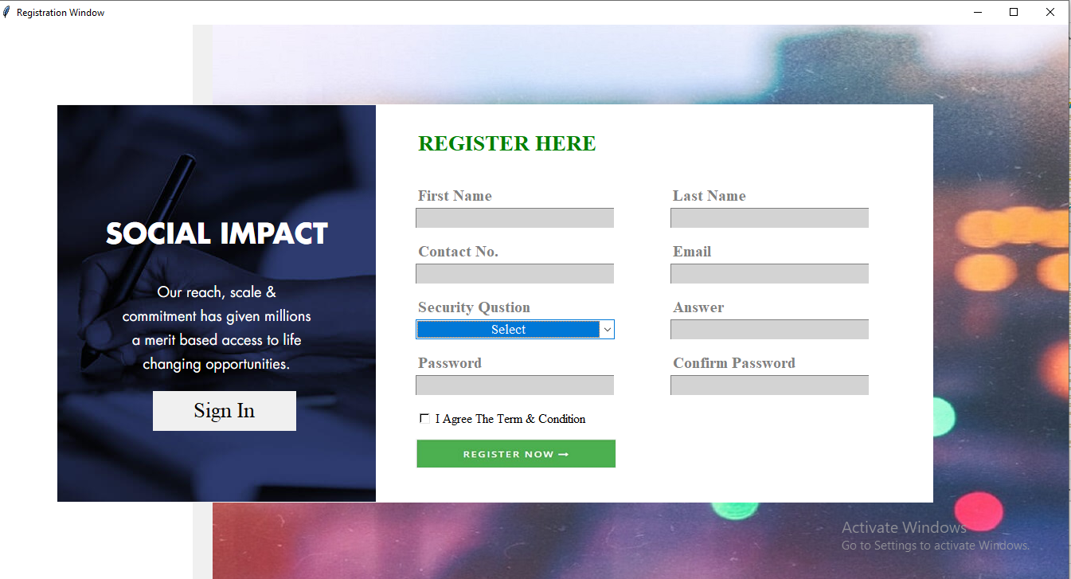
New User Registration
New User Will add his details to register himself for login

Slide 5
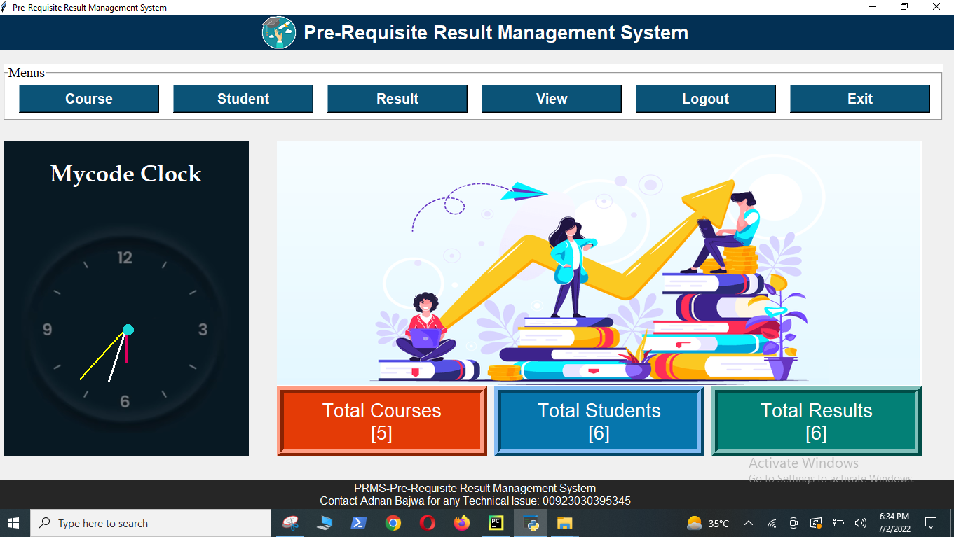
Dashboard
After Successfully login the application dashboard will appear

Slide 6
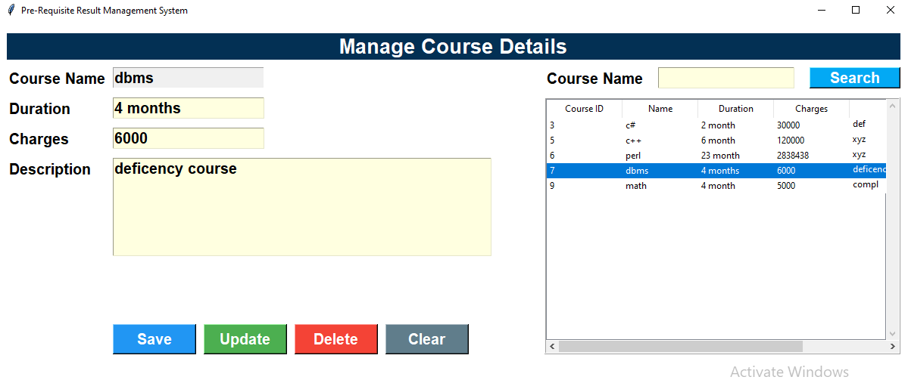
Course Module
Course module will popup after clicking course button on the dashboard
This module register and update the course in course record table

Slide 7
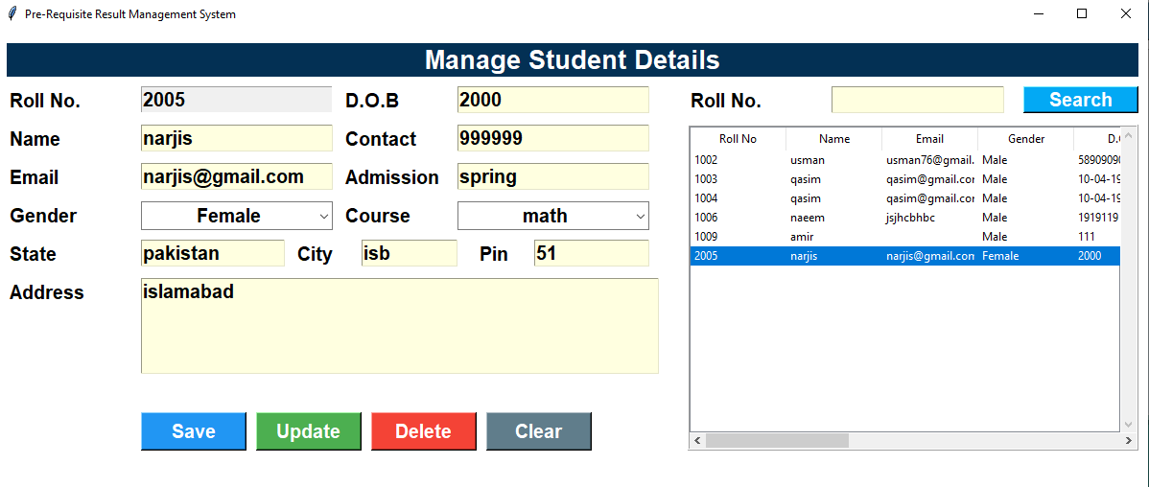
Student Module
Student module will popup after clicking student button on the dashboard
In student module user will enroll/update students record under each pre-requisite course

Slide 8
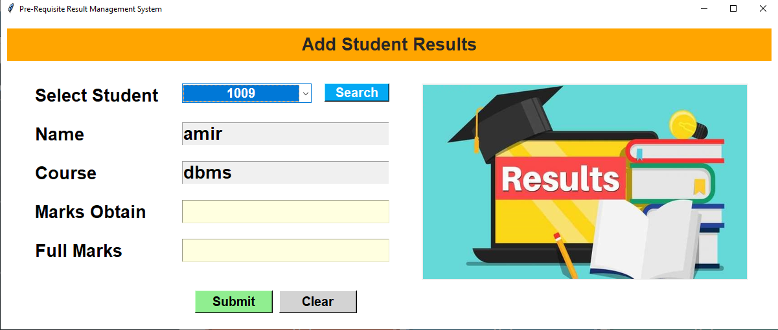
Result Module
Result module will popup after clicking result button on the dashboard
In this module user will add and update the result

Slide 9
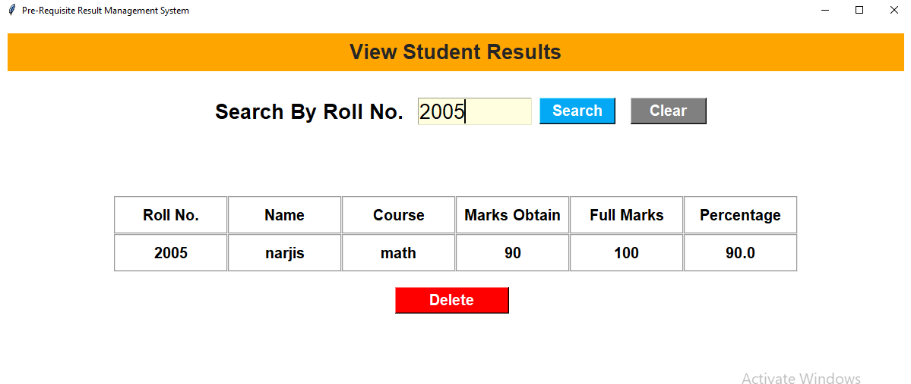
View Module
View module will popup after clicking view button on the dashboard
In this module user could view and delete the result

Slide 10
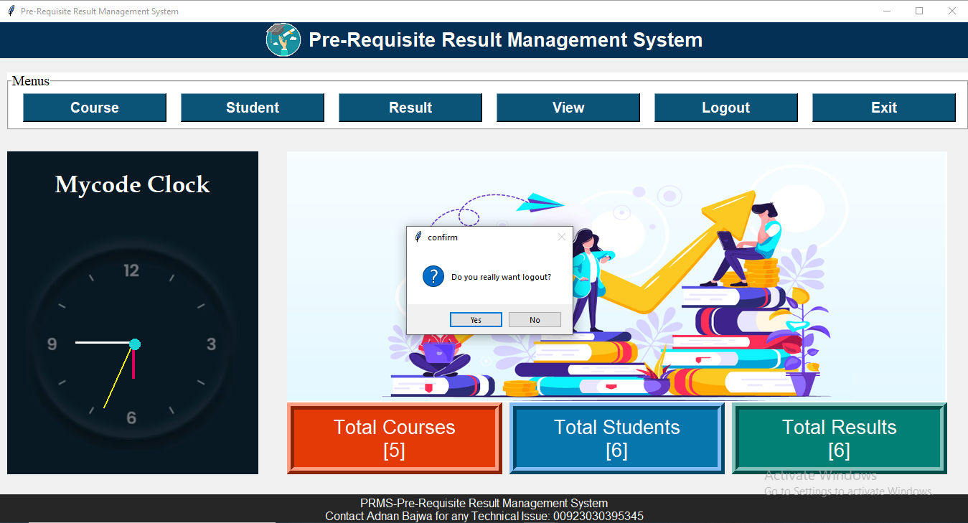
Logout
By clicking logout button on the dashboard , a logout tab will popup
By clicking on yes the login page will appear again

Slide 11
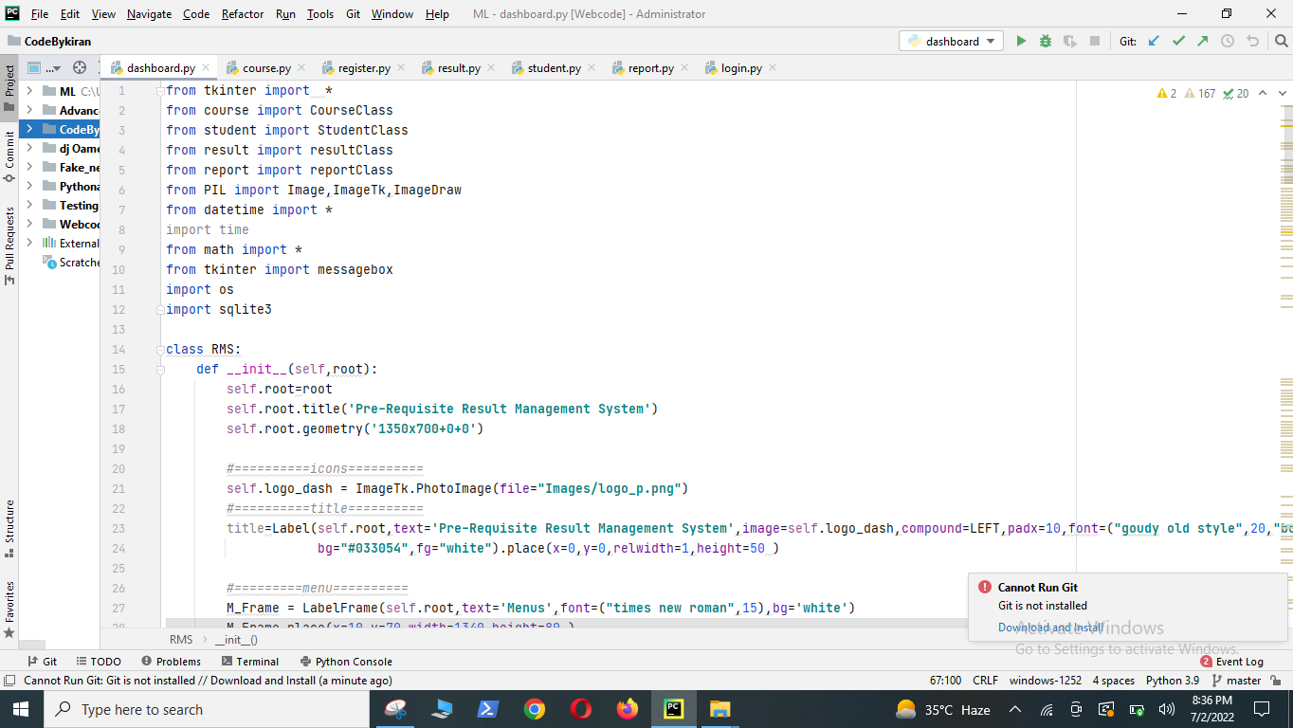
Exit
By clicking the exit button user will exit the application and land back again into IDE

Slide 12


Slide 13


